Slide 1
PlatScribe
Laser Scribe Technology
For
Peel & Share
Portion Control
Easy Open & Reclose
Snap & Go
Food waste reduction
Label replacement
platinumpkggroup.com

Slide 2
What type of Packaging is PlatScribe suitable for?
PlatScribe laser technology can be introduced in a large range of packaging products from trays to horizontal and vertical FFS and pouches
Platinumpkggoup.com

Slide 3
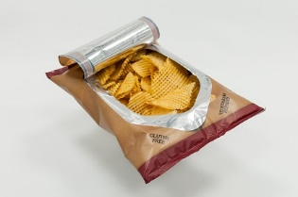
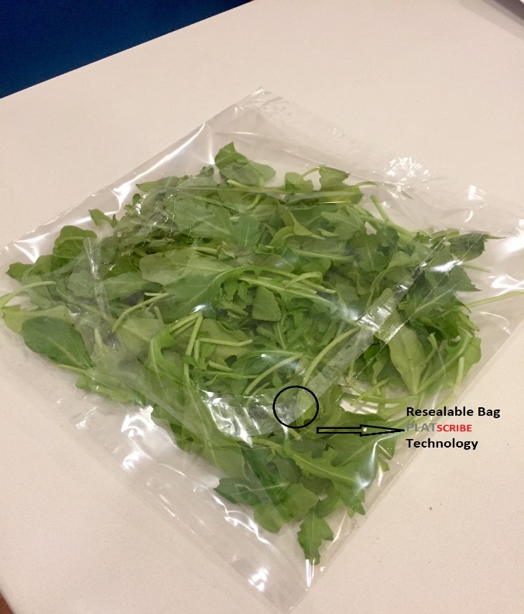
PLATScribe
Multi layer laminate or Mono Layer designed for easy open and Re-Close / Re-sealable Vertical Form Fill and Seal

Slide 4
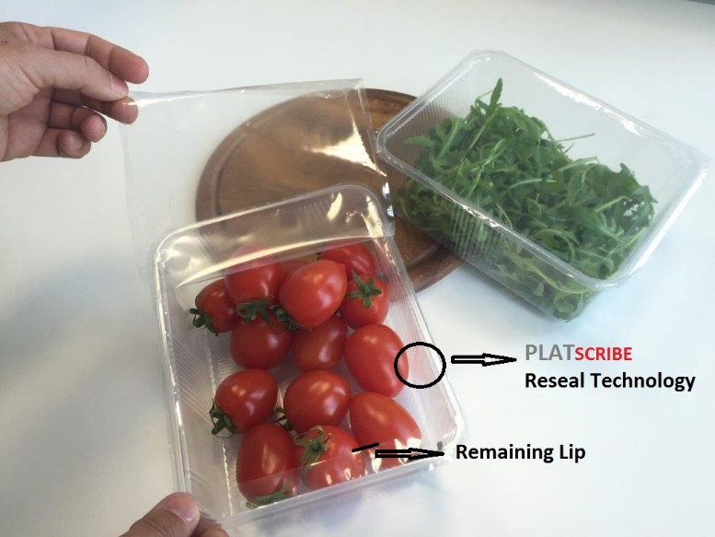
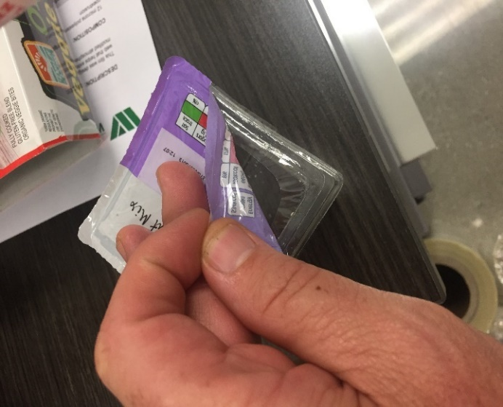
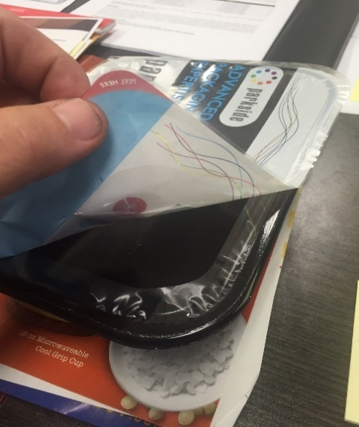
Peel & Reseal PLATScribe
Resealable Film To All Tray Types
Markets: Produce, Snacks , Ready Meals
https://www.youtube.com/watch?v=_JKcWxUIDAo

Slide 5
PLATScribe
Two side lasered packs with a re-closable adhesive designed to remove the need for labels.
Duplex or Triplex Laminates available supplied in standard reels with no need for machine modifications. Suitable for flow wraps and pouches.
Suitable for gas flush high barrier products.
Platinumpkggroup.com

Slide 6
PlatScribe
ReSeal for Trays & Containers
www.platinumpkggroup.com

Slide 7
PlatScribe TM
Reseal for Trays and
Pots
Duplex or Triplex laminate structures available
Can be designed to seal to APET, CPET, RPET, PP and Alu
High Barrier Laminates available
Micro perforation or macro punch holes for Modified Atmosphere Packaging
Suitable for a wide range of products such as nuts, berries, prepared fruits, cooked meats and raw meats
Weld seal to the rim reduces leakers but still allows easy open and re-close due to the reverse laser cut and re-close adhesive
Supplied in standard reels and packs down existing equipment without modification
www.platinumpkggroup.com

Slide 8
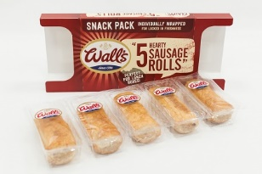
PlatScribe
Snap & Go
Lasered perforated lidding film for portion control trays that allow individual compartments to be snapped off
www.Platinumpkggroup.com

Slide 9
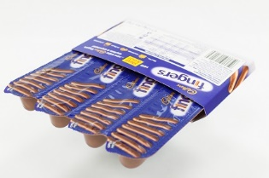
Snap & Go
Produced using mono web PET with a proprietary heat seal layer suitable for peel seals to APET, CPET, RPET and PP trays
www.platinumpkggroup.com

Slide 10
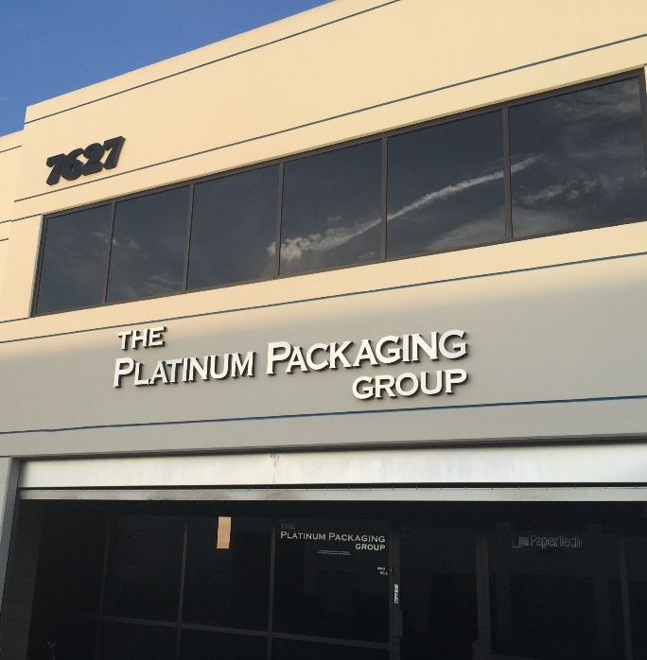
7627 Somerset Blvd, Paramount, CA 90723
Phone: 562 630 6700 www.platinumpkggroup.com

